Slide 1

Personal Finance Management
FSIM2012

Slide 2

Member
Lại Lê Lệ Linh
Lê Thị Minh Khánh
Nguyễn Thị Gấm
Nguyễn Đức Lộc
Nguyễn Anh Tuấn

Slide 3

PFM
English name:
Personal Finance Management
Vietnamese name:
Phần mềm quản lí tài chính cá nhân
Abbreviation: PFM
Product:
Android Mobile

Slide 4

IDEA

Slide 5
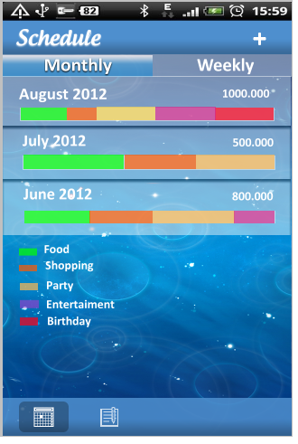
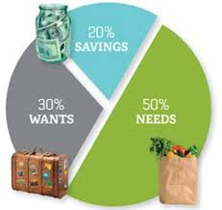
PFM
Function
Schedule for expenditure

Slide 6
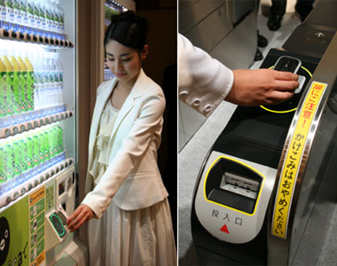
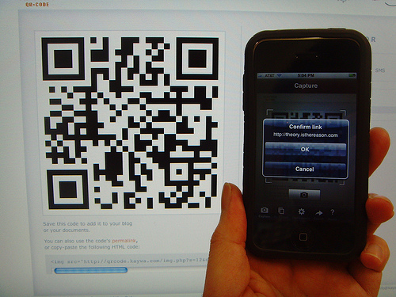
PFM
Function
Expenditure and Income management

Slide 7

PFM
Function
Borrowing and lending money management

Slide 8


PFM
Function
Report at the end of month

Slide 9

PFM
Function
Make a warning for user

Slide 10
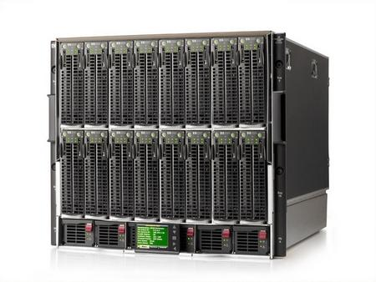
PFM
Function
Synchronize data

Slide 11
PFM
Function
Required function:
Schedule for expenditure
Expenditure and Income management (Input using NFC)
Borrowing and lending money management
Report at the end of month
Make a warning for user
Synchronize data
Optional function:
Input using Q code
Using NFC for payment

Slide 12
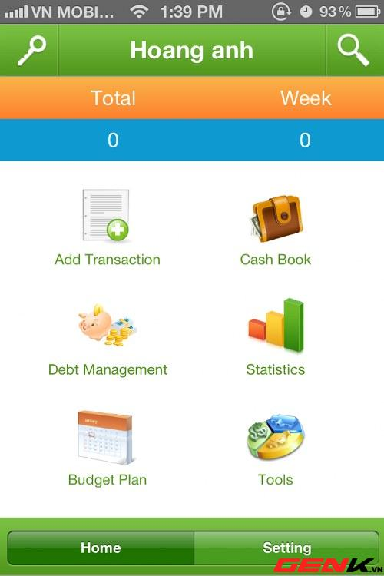
Existing system review
MONEY LOVER
Disadvantages
Does not have a synchronize solution.
It is also uncomfortable for user

Slide 13
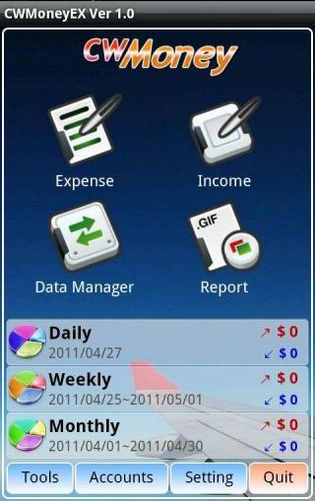
Existing system review
CW MONEY
Disadvantages
Have less function, lack schedule function, borrowing and lending function.
Must purchase to synchronize data.
Have some items are unnecessary for users.

Slide 14
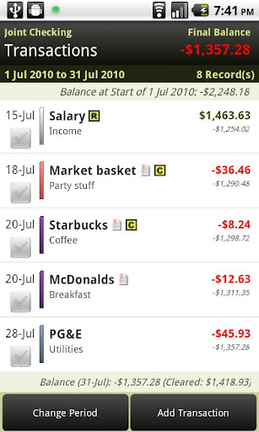
Existing system review
EASY MONEY
Disadvantages
Lack borrowing and lending function.
To use this application, you must buy it.

Slide 15
Plan

